Slide 1
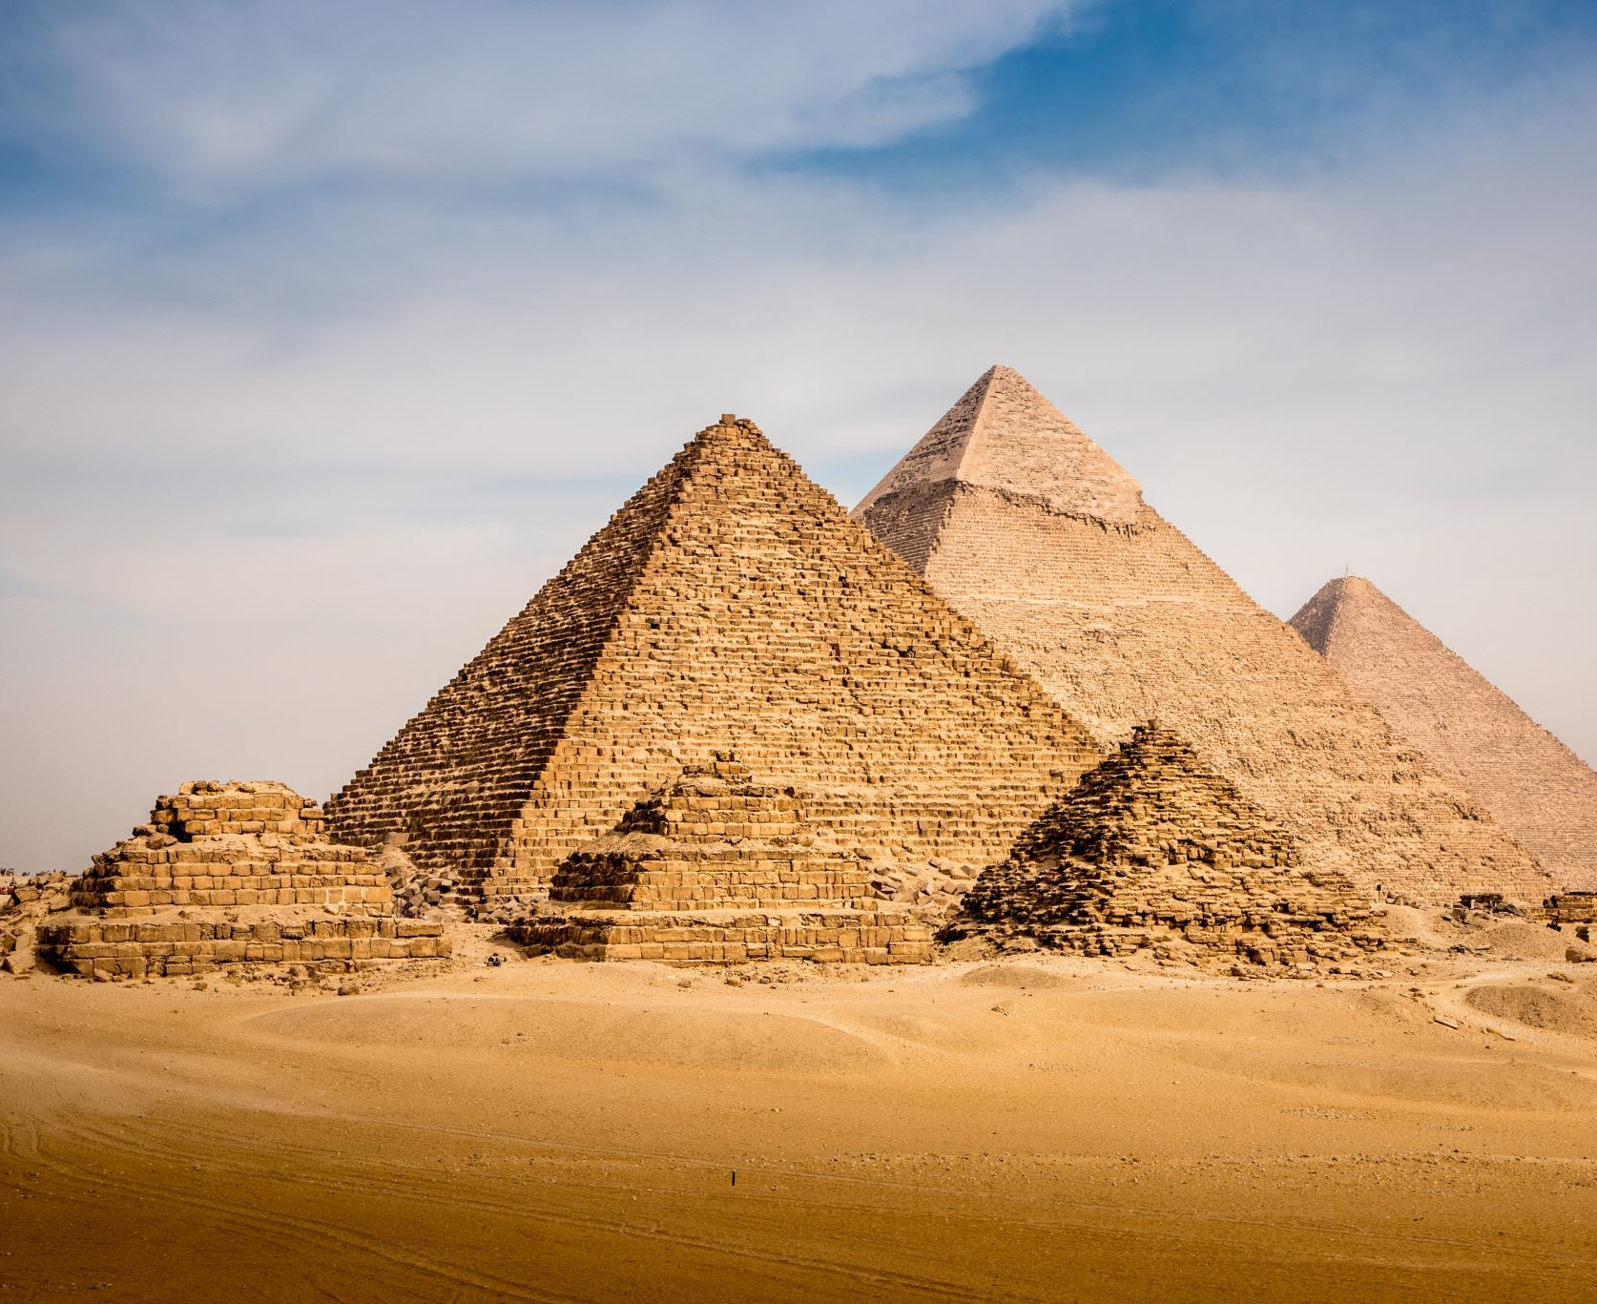
CSE-326 Project scope presentation
1905001 – Mohammad Sadat Hossain
1905002 – Nafis Tahmid
1905004 – Asif Azad
1905008 – Shattik Islam Rhythm
1905015 – Amirul Islam Alif
1905026 – Wasif Hamid

Slide 2
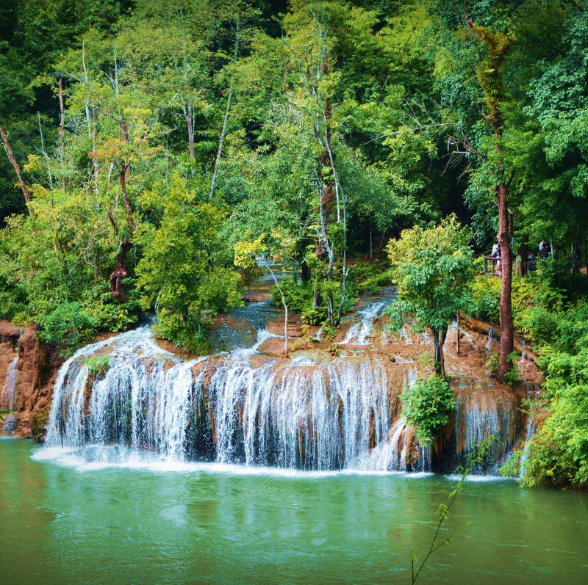
Explore Mate
Your Ultimate Travel Guide

Slide 3
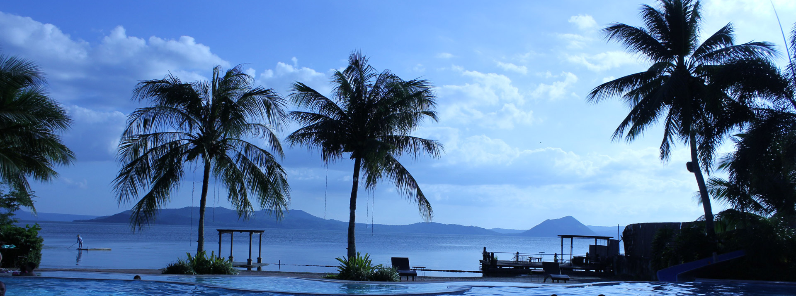
What is ExploreMate?
Discover, plan, and connect with ExploreMate. Find diverse travel options, popular itineraries, and travel companions for an unforgettable journey.

Slide 4

Who is This for?
Any individuals seeking out new experiences and sharing his/her expertise with others.
In this system, we provide a meeting ground for travel enthusiasts, and individuals who have a passion for exploration.

Slide 5

Login and register
Three type of users
Guest User: Explore spots, get recommendations, and discover popular packages without the need to register or login.
Registered User: Share experiences, recommend packages, and write blogs by signing into his/her account.
Admin: Maintain system control and management.

Slide 6

Searching Modules
Travel destinations
Popular plans
Blogs

Slide 7
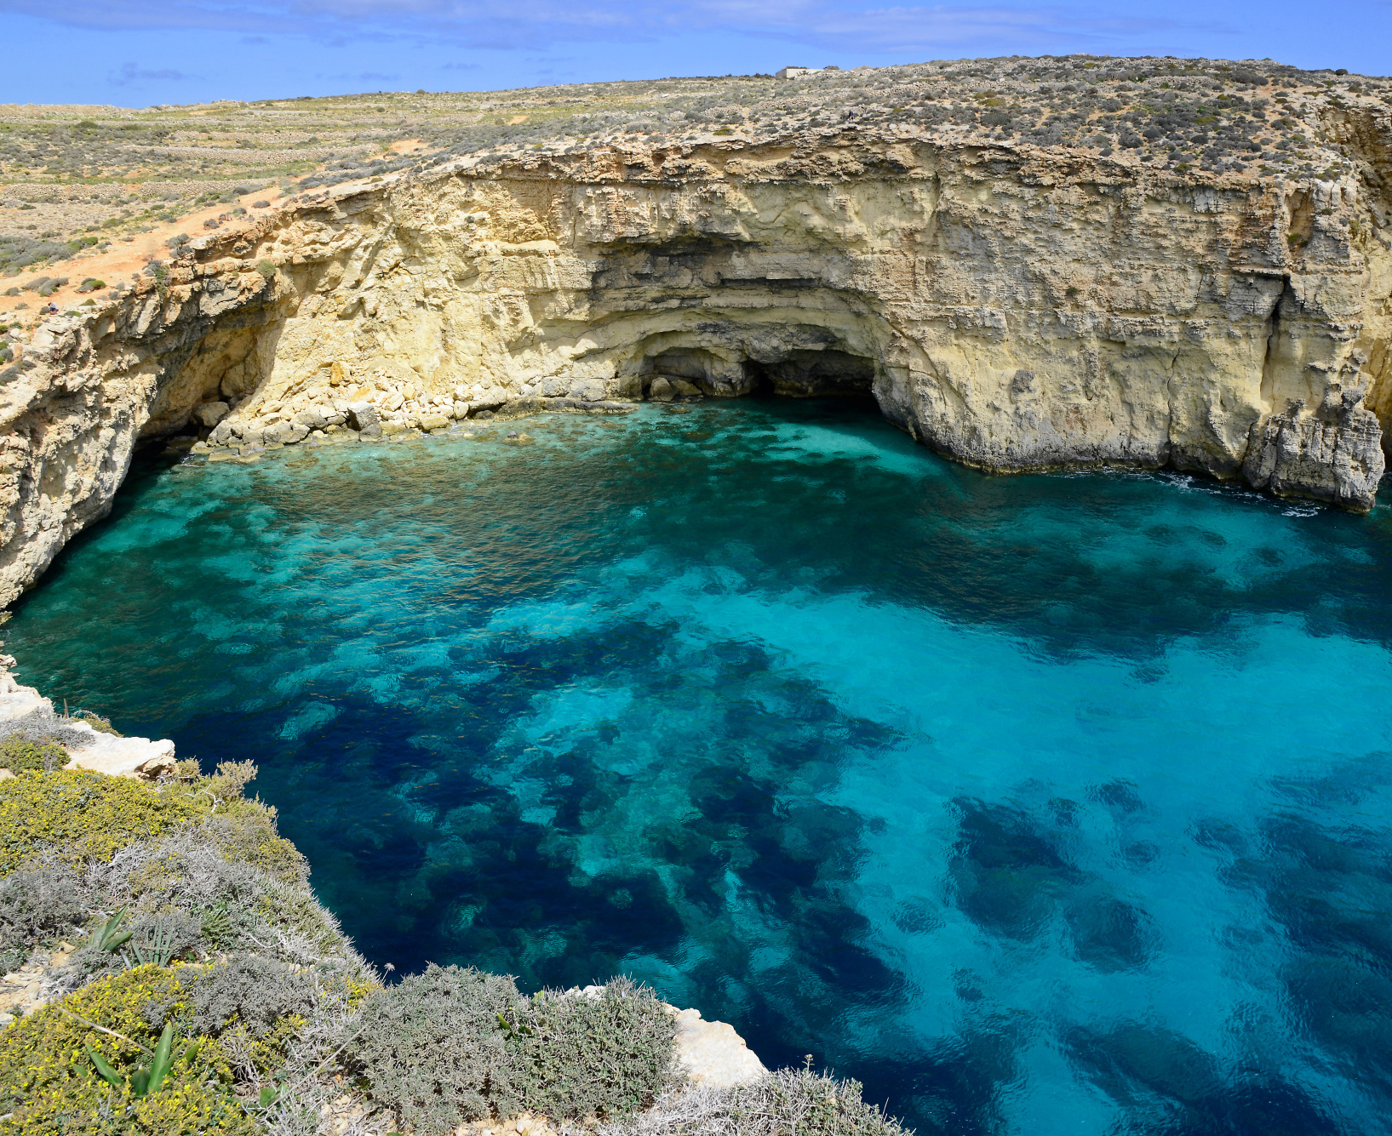
Recommendation system
Customize your travel experience effortlessly. Provide your interests, estimated budgets, and travel duration, and our recommendation system will suggest travel schedule. Discover similar popular travel plans for added inspiration.
This Photo by Unknown author is licensed under CC BY-NC.

Slide 8
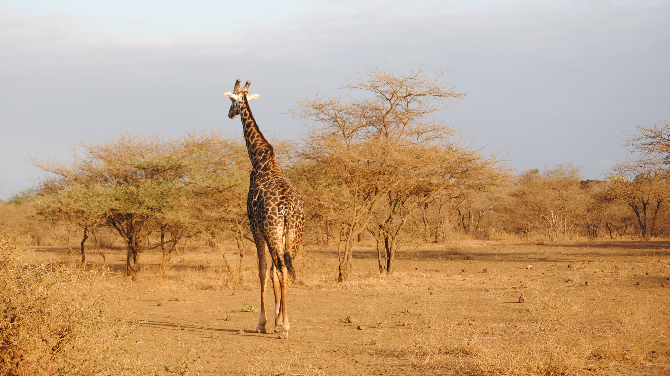
Tracking and blogging
Registered users can keep track of their travels
Rate travel destinations and plans
Share blogs and rate other's

Slide 9
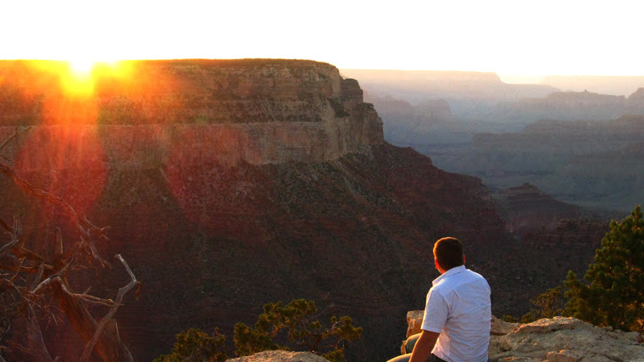
Traveling alone? or...
Wouldn't it be great to have a travel partner who shares similar taste and ideas?
This Photo by Unknown author is licensed under CC BY-NC-ND.

Slide 10
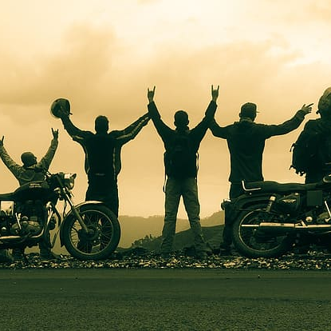
Find Your Travelling companions
Discover your perfect travel companions who share your interests and never feel lonely on your adventures. Unveil your passions and preferred travel duration, and our system will connect you with like-minded travelers who have similar plans, creating memorable experiences together

Slide 11
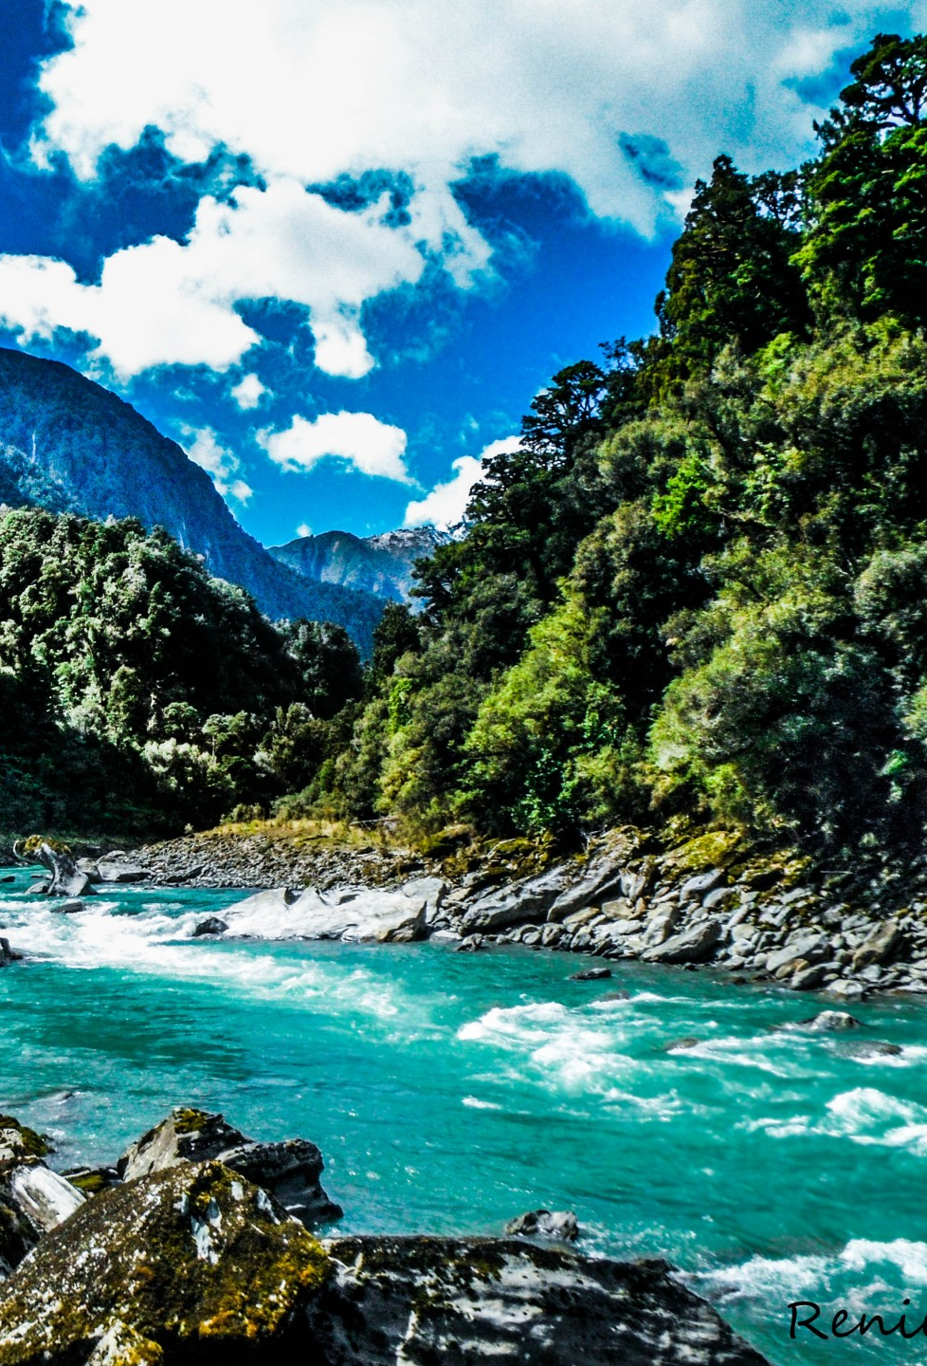
List of major modules
Login and Register
Searching spots, blogs and popular packages
Travel plan recommendation
Travel tracking, blogging and rating
Travelling companion finder

Slide 12
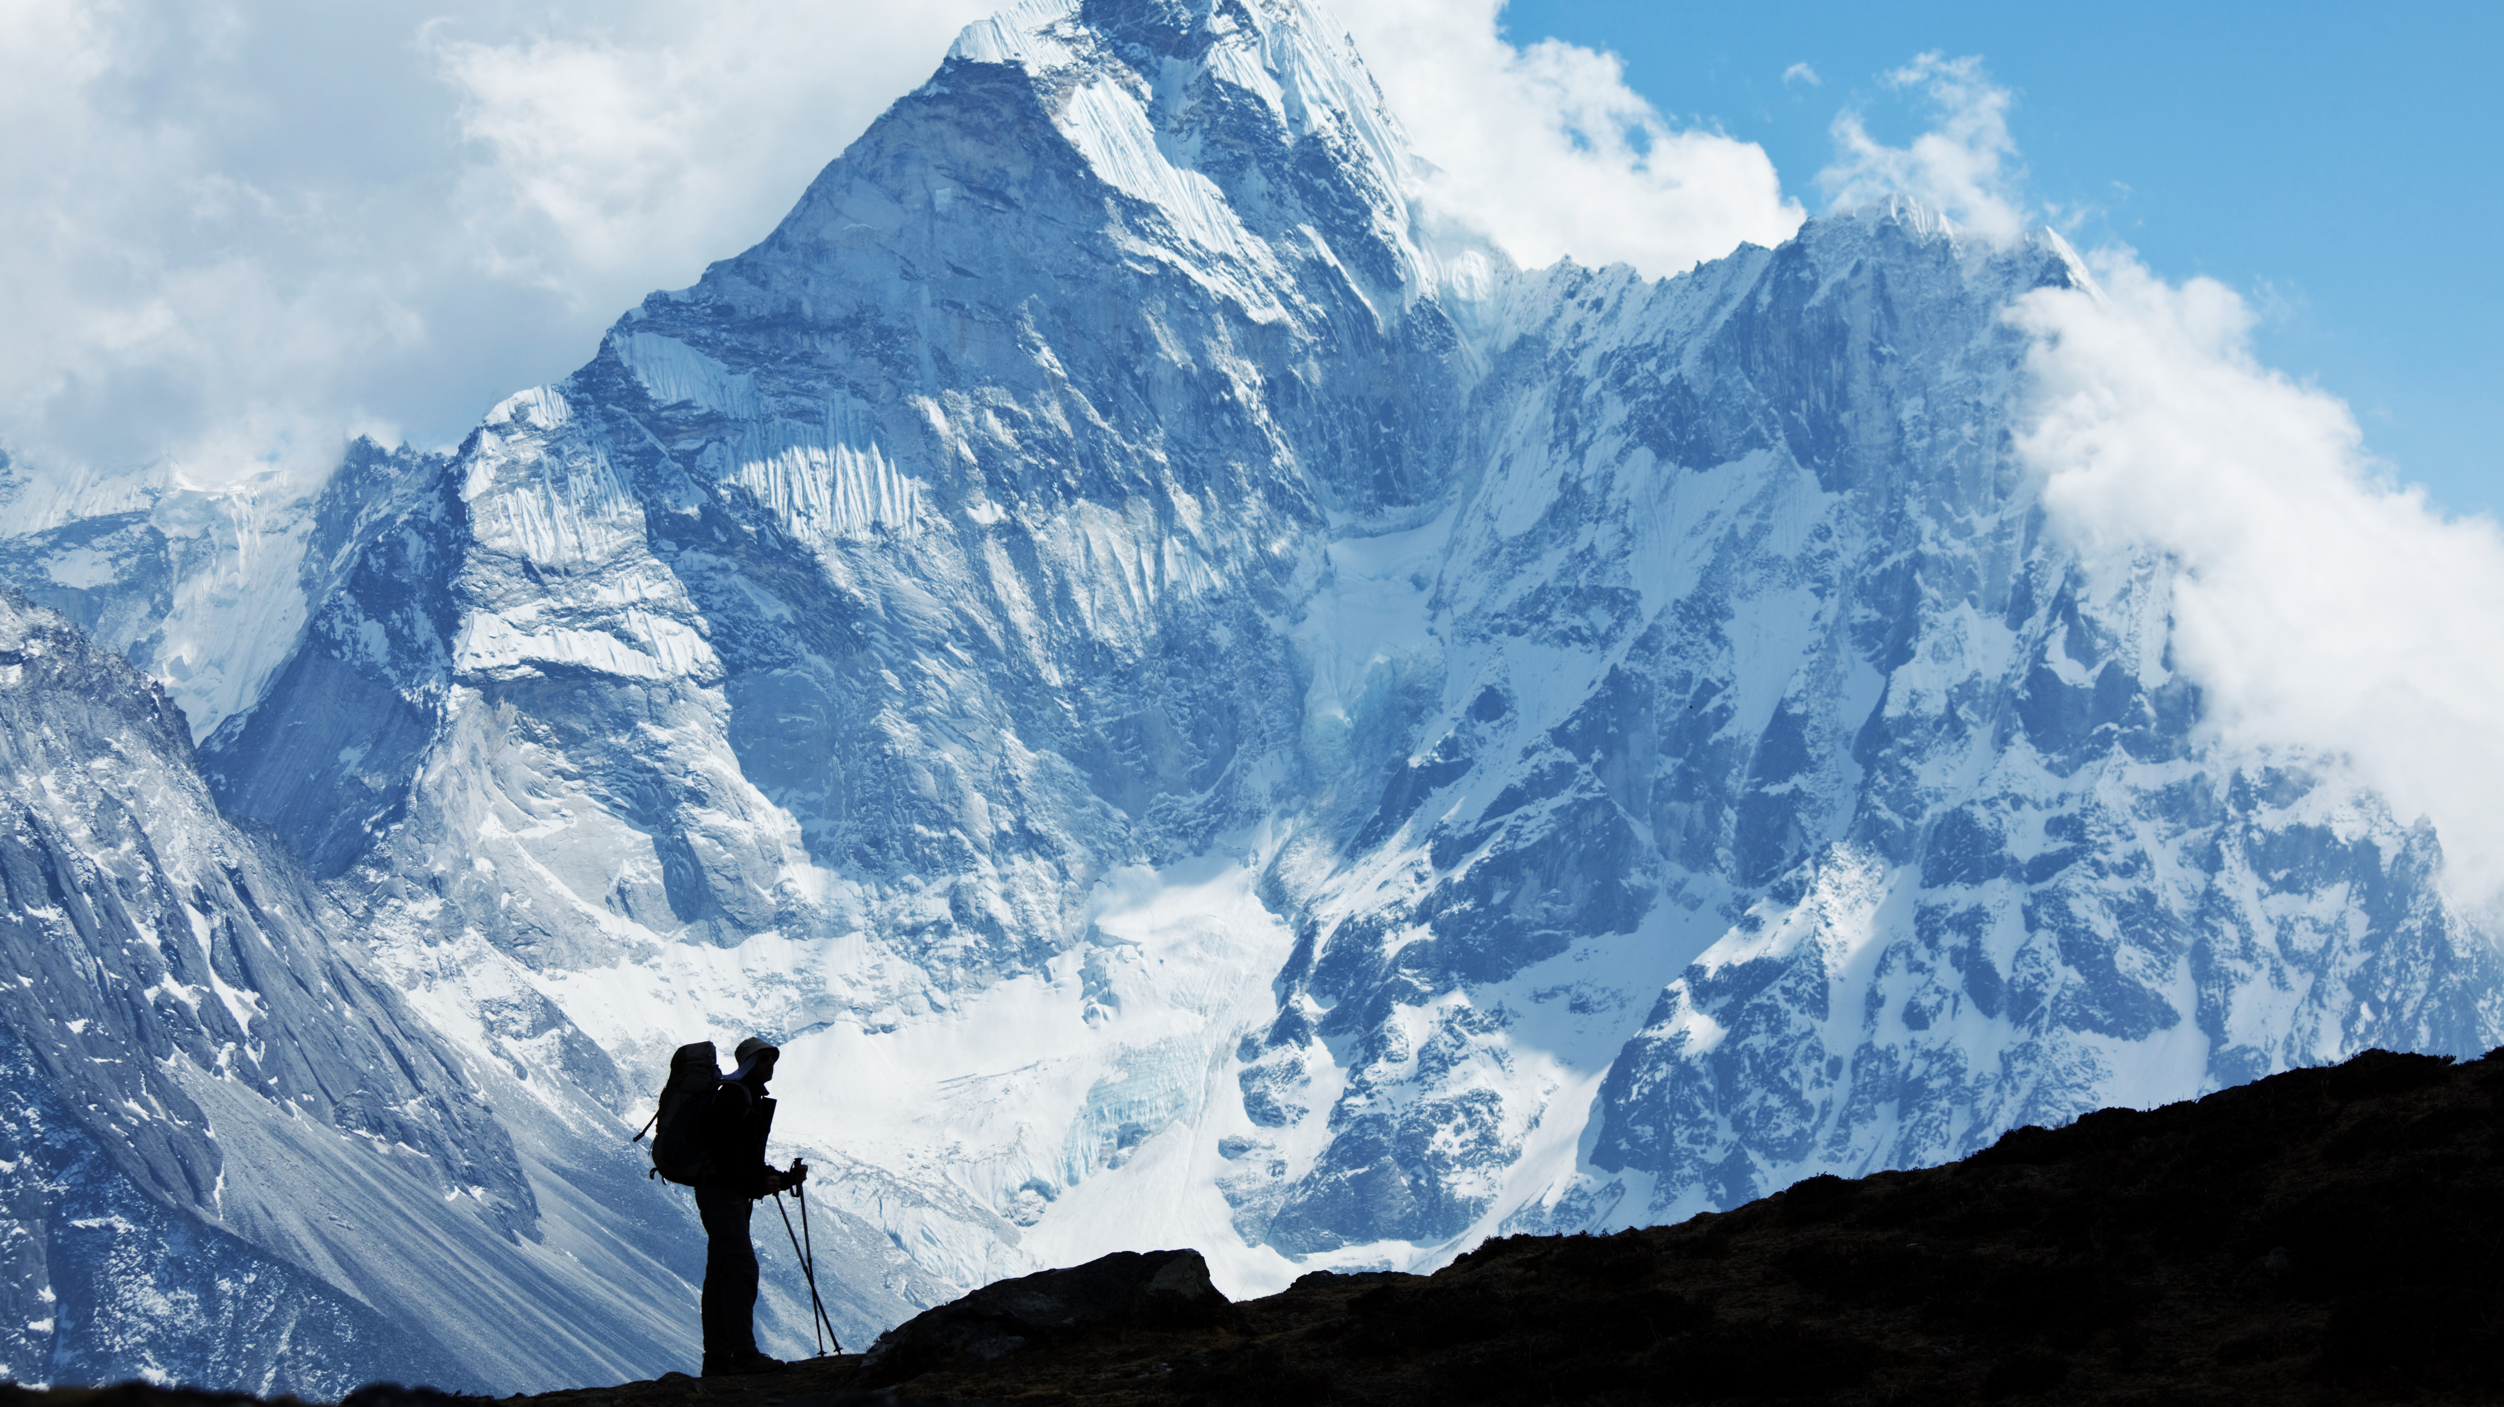
Thank you
This Photo by Unknown author is licensed under CC BY-NC.

